Slide 1
Caregiver-Friendly Workplaces and Policies
This work has been funded by a CIHR Chair in Gender, Work & Health, FRN: CG1 126585
© 2022. Caregiver-Friendly Workplaces and Policies, Dr. Allison Williams, McMaster University. This tool may be used for information, research, education and non-commercial purpose only. It may not be modified, altered or translated in any way. The information provided in the quiz is provided “as-is” without any warranty of any kind, whether express or implied. If you have any questions about the use of this tool, please contact [awill@mcmaster.ca].

Slide 2
Outline
What are Caregiver-Employees?
The Increasing Trend of Caregiver-Employees –
a) Why is this Important?
b) Issues surrounding caregiving
How to Help Caregiver-Employees – Caregiver-Friendly Workplace Policies
Types of Caregiver-Friendly Workplace Policies
Gold Standard Workplaces
How to Implement Caregiver-Friendly Workplace Policies
a) Important notes for employers
b) Barriers in the workplace

Slide 3
Goals
Recognize the varied roles and responsibilities of CEs
Understand ways to increase availability and accessibility of CFWPs
Identify and overcome the obstacles in workplaces

Slide 4
Introduction
Many demographic changes have influenced the paid labour market
Increased of women in the workforce
Smaller family sizes
Restructured health care system with a focus on community care
Increased longevity
Aging workforce (Government of Canada, 2016) (Ireson et al, 2016)

Slide 5
Introduction
By 2050 …
For the first time in history, the number of seniors will surpass number of children
(United Nations, 2013)
Globally, the number of seniors aged 60 and over is expected to double
(United Nations, 2013)
These trends are affecting the growing number of caregiver-employees, given the care needs of the aging population

Slide 6
1. What are Caregiver-Employees?

Slide 7
Caregiver-Employees 1
Caregiver-employees (CEs) are family members and other significant people who provide care and assistance to individuals living with debilitating physical, mental and/or cognitive conditions while also working in paid employment (Ireson et al, 2016)
CEs can be parents, spouses, life partners, adult children, siblings or friends
CEs are employed in all industries and occupations, ranging from small to large workplace sizes and various sectors (Yeandle et al, 2006)

Slide 8
Caregiver-Employees 1
Main tasks of CEs can include
Transportation
Household chores
Personal care
Financial management
Medical care (Government of Canada, 2016)
Why become a CE?
Cultural obligations
Time to give back
Allow family members to age at home
No other alternatives
Personal choice

Slide 9
2. What is the Significance?

Slide 10
Caregiver-Employees 2.a
About 50%
of CEs care for their parents or parents-in-law
(Sinha, 2012)
Majority of CEs work full time while providing care (Fast el al, 2014)
CEs provide an estimated 2.4 billion hours of care (Fast el al, 2014)
6.1 million employed Canadians were providing care to aging family members and friends (Government of Canada, 2016)

Slide 11
Caregiver-Employees 2.a
Productivity losses to employers in Canada
9.7 million days of absenteeism
256 million fewer hours of paid work
Loss of 557,698 CEs who left the paid workforce (Fast et al, 2014)
Loss of $2.7 – 7.7 billion CAD annually due to work counter productivity and absenteeism (Duxbury & Higgins, 2012)
Evidence suggests that once CEs reduce their labour force commitments, they are not as likely to return to previous levels even if their caregiving responsibilities have ended → huge economic and productivity losses (Lilly, 2008)

Slide 12
Issues Surrounding Caregiver-Employees 2.b
Caregiver-employees balance multiple responsibilities and roles
Higher physical, emotional, mental and economic pressures and strain
“Sandwich generation” – individuals between 45-65 years of age caught between child-rearing and eldercare responsibilities (Fast el al, 2014)

Slide 13
Issues Surrounding Caregiver-Employees 2.b
Gender and Caregiving
Women are about as likely as men (51% women vs. 49% men) to become CEs (Fast et al, 2014)
Traditional roles as caregivers → housekeeping, personal care (Fast, 2015)
On average, women cut back their working hours by 10 hours/week vs. men reduce 9 hours/week (Fast et al, 2014)
Women spend more time performing care tasks → women spend 9.5 hours per week on average vs. men spending 6.9 hours (Fast et al, 2014)

Slide 14
3. How to Help CEs – Caregiver-Friendly Workplace Policies

Slide 15
Caregiver-Friendly Workplace Policies 3
Caregiver-friendly workplace policies (CFWPs) are “deliberate organizational changes, in regards to policies, practices or target culture, that reduce work-family conflict and/or support the lives of employees outside of the workplace” (Fast et al, 2014)

Slide 16
Caregiver-Friendly Workplace Policies 3
CFWPs can be found in all workplace sectors, most commonly in the financial, health care and technology sectors (Ireson et al, 2016)
The larger the employer, the more likely that CFWPs were in place for employees (Wagner et al, 2014)

Slide 17
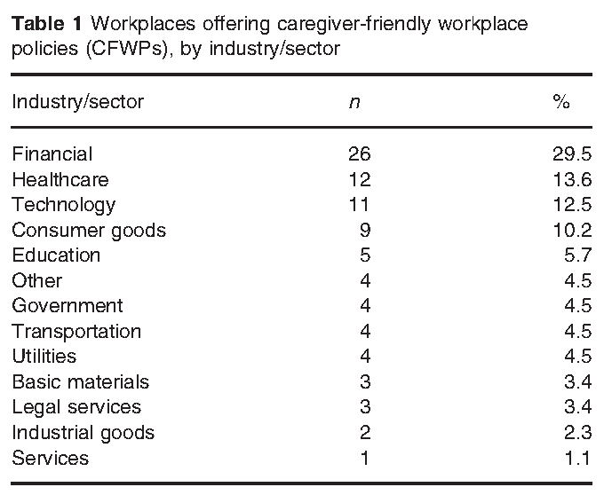
Caregiver-Friendly Workplace Policies 3
The chart below represents findings from a study by Ireson et al in 2016 regarding workplaces that offer CFWPs by industry/sector

Slide 18
4. Types of Caregiver-Friendly Workplace Policies

Slide 19
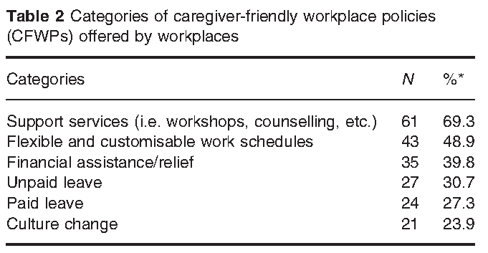
Caregiver-Friendly Workplace Policies 4
There are many types of CFWPs and may include
Support services
Flexible work arrangements
Financial assistance/relief
Paid or unpaid leave
Culture change (Ireson et al, 2016)

Slide 20
Caregiver-Friendly Workplace Policies 4
Support Services
Counseling
Resource and referral services
Support groups
Workshops
Skills training

Slide 21
Caregiver-Friendly Workplace Policies 4
Flexible Work Arrangements
Flexible scheduling
Vary working hours
Job sharing
Compressed weeks
Telework
Financial Assistance/Relief
Employee Assistance Programs (EAPs)
Insurance coverage

Slide 22
Caregiver-Friendly Workplace Policies 4
Paid or Unpaid Leave Options
Paid/unpaid leaves of absence (longer than government mandated)
Family and emergency days off
Culture Change
Management is responsive to work-family issues promoting family-friendliness
Ie. management/supervisor training and resources via seminars
Did You Know? – In Ontario, family caregiver leave is unpaid, job-protected leave for up to 8 weeks per year (Ministry of Labour, 2015)
Notes:
http://www.labour.gov.on.ca/english/es/pubs/brochures/br_leaves.php

Slide 23
Caregiver-Friendly Workplace Policies 4
Benefits of CFWPs in the workplace include
Increased job satisfaction and commitment
Decreased employee absenteeism
Increased employee retention
Less employee turnover
Positive company reputation
Increased productivity
Increased health and wellbeing because of better work-life balance (Fast et al, 2014) (Kelly et al, 2009) (Yeandle et al, 2006) (Ireson et al, 2016)

Slide 24
Food for Thought
1. What type(s) of CFWPs do you think are the most common? Why?

Slide 25
Food for Thought
Answer: Support services are the most common CFWPs in workplaces. The most common CFWPs are the easiest to implement and usually the most inexpensive. In descending order following support services are flexible work arrangements, financial assistance/relief, paid/unpaid leave options, and culture change

Slide 26
Food for Thought
2. Do you think it is better to have a one size fits all approach or a case-by-case approach to CFWPs in the workplace? Why?

Slide 27
Food for Thought
Did You Know? – Most managers and supervisors address employee requests about CFWPs are handled on a case-by-case basis (Fast, 2015)
Suggested Answers:
Benefits for having one size fits all policies:
Ensures that there is a set guideline
Benefits for having case-by-case policies:
Allows flexibility because every employee has a different circumstance
Drawbacks of having one size fits all policies:
Some employees will have different needs and some policies may not be advantageous to them
Drawbacks of having case-by-case policies:
Could signify lack of appropriate workplaces policies available to address specific needs (Lero et al, 2012)

Slide 28
5. CFWPs in Gold Standard Workplaces

Slide 29
Gold-Standard Workplaces 5
GlaxoSmithKline
Has been named one of the 50 Best Employers in Canada by Maclean’s (GlaxoSmithKiline, 2012)
Compassionate Leave Program – up to 13 weeks paid leave over 2 years
Self-managed time – employees can work flexible hours and compressed weeks
Employee Assistance Program – offers services for eldercare services, counseling
Notes:
Compassionate leave program – up to 13 weeks paid leave over a two year period
-employees with at least 3 years of service receive 13 weeks pay full salary
http://ca.gsk.com/media/522355/innovative_programs.pdf

Slide 30
Gold-Standard Workplaces 5
Deloitte
Named one of Canada’s Top 100 Employers in 2016 (Canada’s Top Employers, 2016)
Long-Term Care – coverage that protects you or family members from high costs associated with nursing home stays and home health care services
Employee Assistance Program – provides support, guidance, education/training and solutions
Emergency Back-Up Dependent Care – care service for a maximum of 30 days per employee per year when regular elder care is unavailable and employee needs to be at work
Notes:
-emergency back-up dependent care can be used when employee needs to be at work but regular elder care is unavailable
http://www2.deloitte.com/us/en/pages/careers/articles/life-at-deloitte-benefits-and-rewards.html

Slide 31
Gold-Standard Workplaces 5
BT Group plc
Awarded one of Top Employers for Working Families in 2014 (Top Employers for Working Families, 2014)
Offers flexible working times for short and long term
Family and You Portal – provide advice for employees and guides them through options available for them ie. Information about flexible work
Job sharing, stepping down (move to lower pay grade), erase down (gradually reduce hours or job responsibilities)
Technology as an enabler – teleconferencing and video conferencing
Notes:
http://www.topemployersforworkingfamilies.org.uk/index.php/special-awards/case/bt-group-plc

Slide 32
6. Implementing CFWPs

Slide 33
Implementing CFWPs in the Workplace 6.a
CFWPs can be incorporated into workplace policies and practices through cooperation between employers, employees and the government and law-making bodies
Employers can:
Emphasize the importance of work-life balance
Promote a family-friendly workplace
Educate managers and supervisors on programs, policies and information
Increase awareness of programs and support available
Accept diversity in the workplace
Allow open discussion with employees to find out how they can be best supported

Slide 34
Implementing CFWPs in the Workplace 6.a
Communication is key
Much of the time, employees do not know about available policies
Important to have open relationships with managers/supervisors and employees
Awareness and Understanding
Supportive Managers

Slide 35
Barriers to Implementing CFWPs 6.b
Lack of awareness
Workplaces do not know the magnitude of the problem
Do not know how to access needed information
Recognize gendered nature of caregiving
Nature of the job
Some jobs can be easily replaced but other highly skilled jobs take long to train and replace
Leadership support
Role of managers is crucial
Importance of supportive environment (Government of Canada, 2015)

Slide 36
Conclusions
Recognize the varied roles and responsibilities of CEs
Broaden availability and accessibility of CFWPs
Identify and overcome the obstacles in workplaces

Slide 37
Thank you! Questions?

Slide 38
References
Deloitte. (2016). Benefits and rewards. Retrieved from: http://www2.deloitte.com/us/en/pages/careers/articles/life-at-deloitte-benefits-and-rewards.html#
Duxbury, L. & Higgins, C. (2001). Work-life balance in the new millennium: where are we? Where do we need to go?. Retrieved from: http://cprn.org/documents/7314_en.PDF
Duxbury, L. & Higgins, C. (2012). Balancing Work, Childcare, Eldercare: A View from the Trenches. Retrieved from: http://sprott.carleton.ca/wp-content/files/Duxbury-BalancingWorkChildcareEldercare-ExecSummary.pdf
Fast, J. (2015). Caregiving for Older Adults with Disabilities : Present Costs, Future Challenges. Retrieved from: http://irpp.org/research-studies/study-no58/
Fast, J., Lero, D., DeMarco, R., Ferreira, H. & Eales, J. (2014) Combining care work and paid work: Is it sustainable?. Retrieved from: http://www.rapp.ualberta.ca/en/~/media/rapp/Publications/Documents/Combining_care_work_and_paid_work_2014-09-16.pdf
Fast, J., Keating, N., Lero, DS., Eales, J. & Duncan, K. (2013). The Economic Costs of Care to Family/Friend Caregivers: A Synthesis of Findings. Print.
Ferrer, A & Gagné, L. (2007). The use of family-friendly workplace practices in Canada. Retrieved from: http://kooperationen.zew.de/fileadmin/user_upload/Redaktion/DFGFLEX/ws07Ferrer_Gagne.pdf
GlaxoSmithKline. (2011). GlaxoSmithKline celebrates 11 years as one of the 50 Best Employers in Canada. Retrieved from: http://ca.gsk.com/en-ca/media/press-releases/2011/glaxosmithkline-celebrates-11-years-as-one-of-the-50-best-employers-in-canada/

Slide 39
References
Government of Canada. (2016). Flexible Work Arrangements: A Discussions Paper. Retrieved from: http://www.esdc.gc.ca/en/consultations/labour/flexible_work_arrangements/discussion_paper.page?ct=t%28May+2016+news_2016-05-02%29&mc_cid=1bf88a396b&mc_eid=%5BUNIQID%5D
Government of Canada. (2016). Report from the Employer Panel of Canada. Retrieved from: http://www.esdc.gc.ca/eng/seniors/reports/cec.shtml
Government of Canada. (2015). When work and caregiving collide: how employers can support their employees who are caregivers. Print.
Hewitt, A. (n.d.) What’s in it for you?: GlaxoSmithKline. Retrieved from: http://ca.gsk.com/media/522355/innovative_programs.pdf
Ireson, R., Sethi, B. & Williams A. (2016). Availability of caregiver-friendly workplace policies (CFWPs): an international scoping review. Retrieved from: http://onlinelibrary.wiley.com/doi/10.1111/hsc.12347/epdf
Kelly, EL., Kossek, EE., Hammer LB., Durham, M., Bray, J., Chermack, K., Murphy LA. & Kaskubar, D. (2009). Getting there from here: research on the effects of work-family initiatives on work-family conflict and business outcomes. Retrieved from: http://www.tandfonline.com/doi/full/10.1080/19416520802211610
Lilly, M. (2008). The Labour Supply of Unpaid Caregivers in Canada. Retrieved from: https://tspace.library.utoronto.ca/bitstream/1807/11226/1/Lilly_Meredith_L_200806_PhD_thesis.pdf
Ministry of Labour. (2015) Leaves of Absence. Retrieved from: http://www.labour.gov.on.ca/english/es/pubs/brochures/br_leaves.php
Sinha, M. (2012) Portrait of Caregivers. Retrieved from: http://www.statcan.gc.ca/pub/89-652-x/89-652-x2013001-eng.pdf

Slide 40
References
Top Employers for Working Families. (2014). BT Group plc. Retrieved from: http://www.topemployersforworkingfamilies.org.uk/index.php/special-awards/case/bt-group-plc
United Nations. (2013). World Population Ageing 2013. Retrieved from: http://www.un.org/en/development/desa/population/publications/pdf/ageing/WorldPopulationAgeing2013.pdf
Wagner, DL., Lindemer, A., Yokum, N. & DeFreest, M. (2012). Best practices in workplace eldercare. Retrieved from: http://www.caregiving.org/wp-content/uploads/2010/01/BestPracticesEldercareFinal1.pdf
Yeandle S., Bennett, C., Buckner, L., Shipton, L. & Suokas, A. (2006). Who cares wins: the social and business benefits of supporting working carers. Retrieved from: http://circle.leeds.ac.uk/files/2012/09/who-cares-wins-full-report.pdf
Zeytinoglu, IU. (2005). Flexibility in Workplaces: Effects on Workers, Work Environment and the Unions. Retrieved from: http://www.ilo.org/public/english/iira/documents/publications/flexibility.pdf

